Slide 1
Day 6: introduction to google earth engine and github
Takaaki Masaki
Revocatus Paul

Slide 2
Today’s Agenda
Introduction to Google Earth Engine
Introduction to GitHub

Slide 3
Introduction to Google Earth Engine

Slide 4
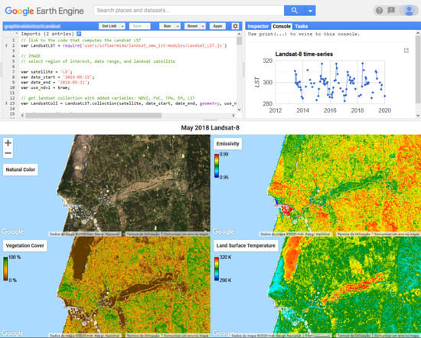

Google Earth Engine (with Python)
Google Earth Engine combines a multi-petabyte catalog of satellite imagery and geospatial datasets with planetary-scale analysis capabilities.
This segment of the training introduces you to GEE and how to work with it through geemap package in Python

Slide 5
What is GEE?
https://youtu.be/gKGOeTFHnKY

Slide 6

Let’s sign up for GEE
Sign in using your own Gmail on Google Chrome
Select “Get started” on the GEE website
Follow instructions to create your own GEE project

Slide 7
Setting things up
To use GEE through Python, you first need to install Anaconda, Python, and geemap package
Anaconda: a free, open-source distribution of Python and R for data science and machine learning. It includes over 250 pre-installed packages, such as SciPy, Malplotlib, Pandas, and NumPy, which are used in scientific computing.
Python: computer programming language often used to build websites and software, automate tasks, and conduct data analysis
geemap package: Python package for interactive geospatial analysis and visualization with Google Earth Engine (GEE)
Notes:
For details on installation process, see https://www.cse.unsw.edu.au/~en1811/resources/getting-started/install-anaconda.html.

Slide 8

Get Python and geemap Package
To use GEE through Python, you first need to install Anaconda, Python, and geemap package
After Anaconda is stalled, go to Anaconda Prompt, which will open a new window like below. You can type in “Anaconda Prompt” in your Search bar and it should appear.
Notes:
For details on installation process, see https://www.cse.unsw.edu.au/~en1811/resources/getting-started/install-anaconda.html.

Slide 9
Get Python and geemap Package
Copy and paste the following commands into the prompt:
conda create -n gee python=3.11
conda activate gee
conda install -n base mamba -c conda-forge
mamba install geemap -c conda-forge
mamba install geopandas localtileserver -c conda-forge
pip install geemap
pip install --upgrade jupyter

Slide 10
Get Python and geemap Package
Now you are ready to use GEE!
Type in the following in Anaconda Prompt:
cd “**path**“
jupyter notebook
**This path should be where your .ipynb code exists.
Jupyter Notebook: server-client application that allows editing and running notebook documents via a web browser
This will take you to a web browser where you can write scripts to run analysis in Python (or other programming languages)

Slide 11
Example 1: Working with NDVI data through GEE
Notes:
https://book.geemap.org/chapters/11_applications.html

Slide 12
Introduction to GitHub

Slide 13
Reproducibility – a crisis
The ability to duplicate the results of a prior study using the same results of a prior study using the same materials and procedures as were used by the original investigator – Bollen et al (2015)
Most researchers, at one point, have been unable to reproduce their own results
This happens quite often at our institution as well
How many of us have run our own programs and get different results?
How many of us have shared a project with a colleague and she gets different results? Or a colleague shares a project with you and you can’t reproduce their published results?

Slide 14
Reproducibility requires planning
Reproducibility can only be achieved if you have the following ingredients in place:
The same software is used
The same programs are used – e.g. do-files and ados
The same data is used
When things go right no one notices, but when they don’t it’s a different story.
Today we will go over how to set things up so you can achieve this with less pain

Slide 15
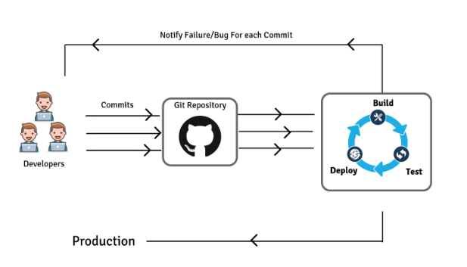
What are Git and Github?
Git is a developer application that allows for version control, allowing you to:
Revert files or the whole project to an earlier state;
Compare changes over time;
See who modified what;
Control modifications by collaborators by permission of admin/owners.
GitHub is a repository hosting service for Git, providing a web-based graphical interface that works on top of Git. It can also be treated as a social platform to share knowledge and work or provide access control and several collaboration features.

Slide 16
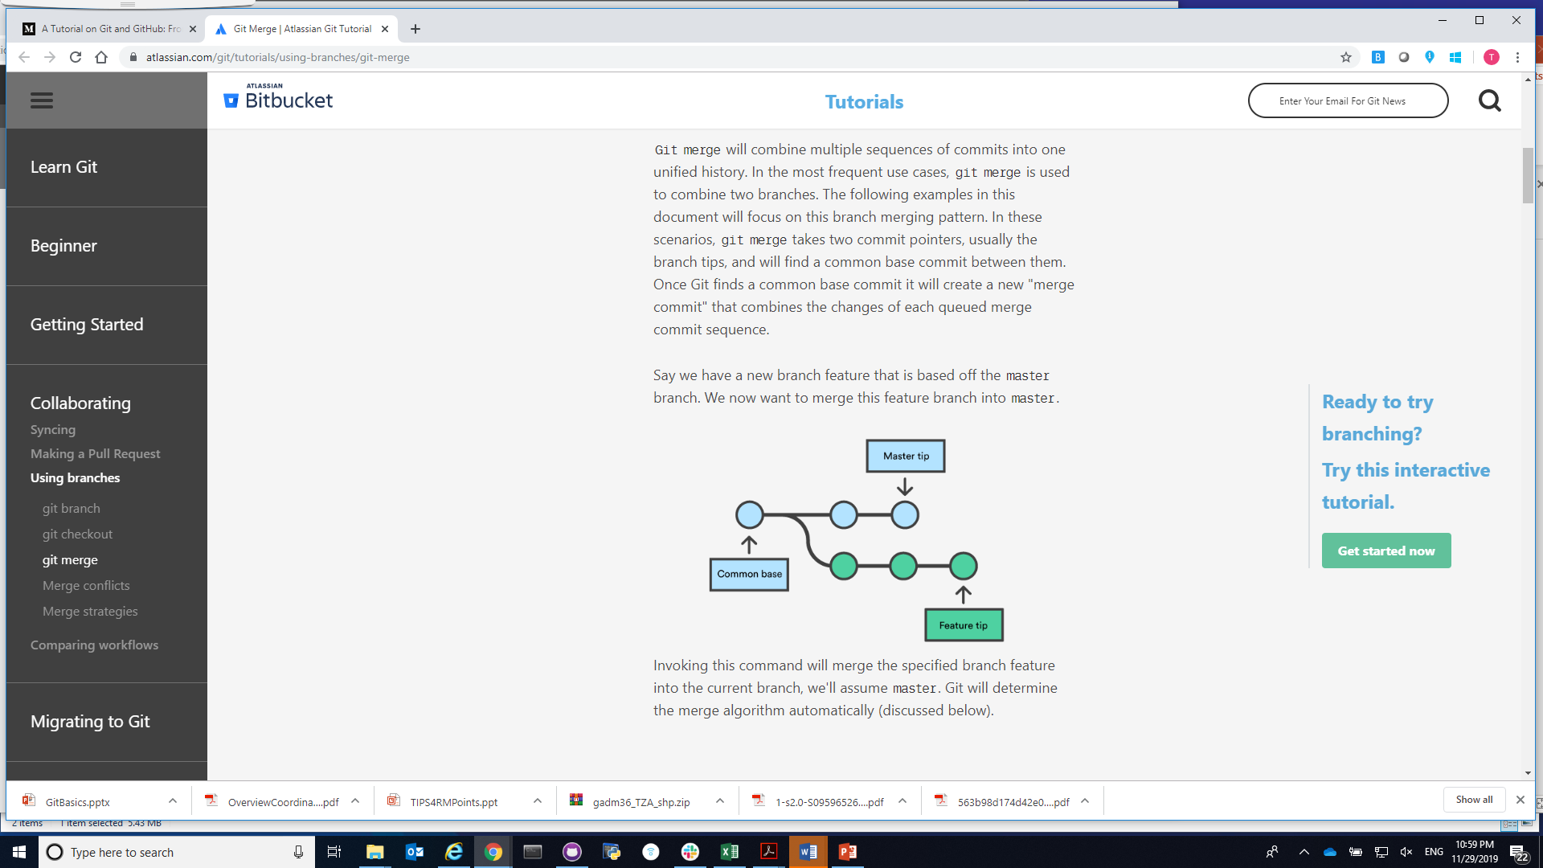
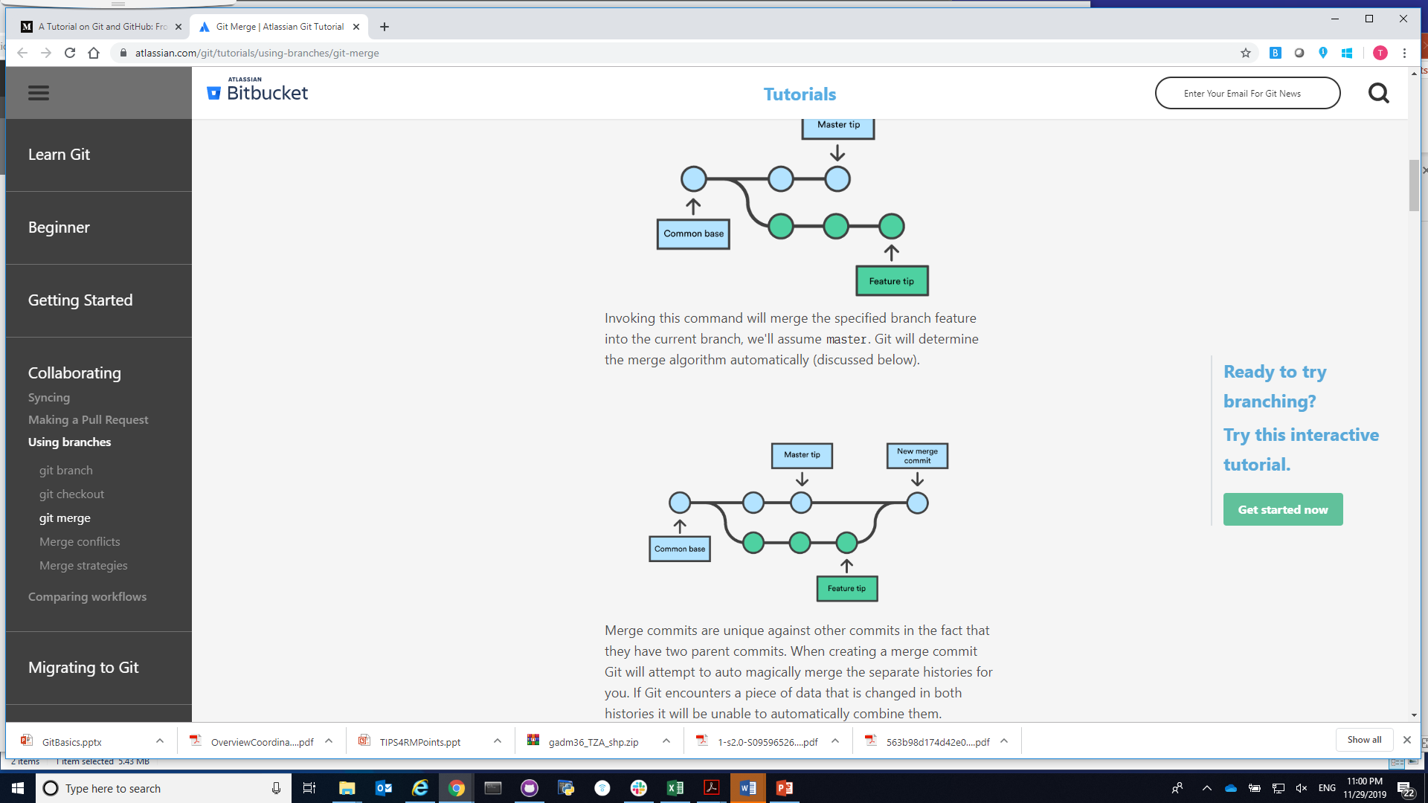
Workflow through github
Create a "repository" (project)
Copy (or clone) the repository to your local machine
Add a file to your local repo and "commit" (save) the changes
Create a "branch" (version), make a change, commit the change
Open a "pull request" (propose changes to the master branch) (Use Case 1)
["Merge" your branch to the master branch] (Use Case 2)

Slide 17
Hands-on practice

Slide 18
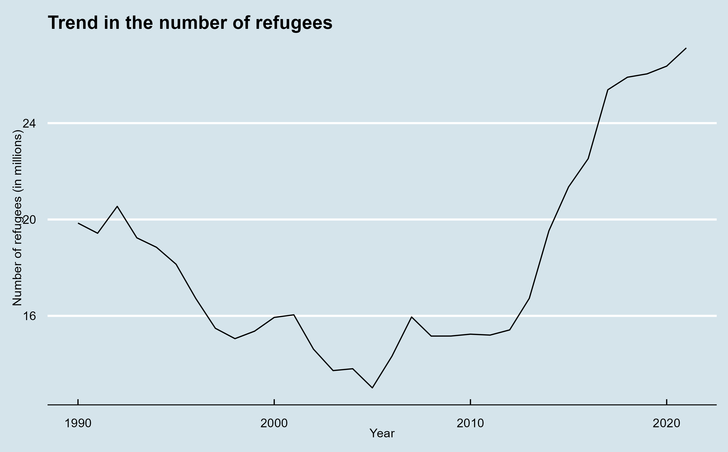
Our goal

Slide 19
Setting up github and github desktop
Create your own GitHub account here.
You can use your own personal email or work email to sign up.
Please use Google Chrome, Firefox, or Safari as GitHub does not work on Internet Explorer.
Download GitHub Desktop here
GitHub Desktop is a Graphical User Interface (GUI) that allows you to work efficiently with GitHub repositories and implement various features (e.g., push, pull, branch, merge)
Please note that there are other GUIs available like GitKraken, SourceTree, among others. Check to see which one best fits your needs.

Slide 20
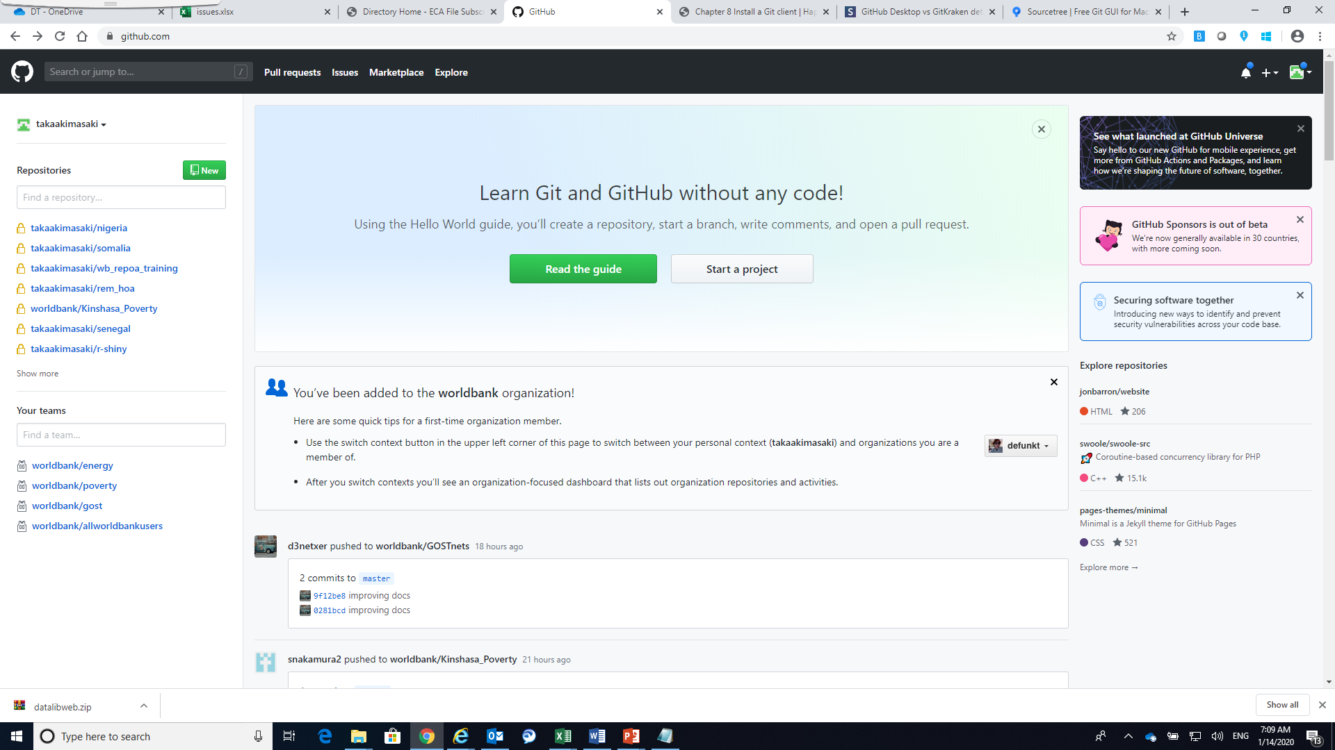
Create a repository
Go to your GitHub page
Create a new repository by clicking on
Set a repository name
You have the option of making the repository public or private
If set private, no one except for your collaborators can see what’s in the repository. But then, there is a limit on the number of collaborators (up to 3) you can have for private repositories.
If set public, all the items in the repository will be made public. There is no limit on the number of collaborators for public repositories.

Slide 21
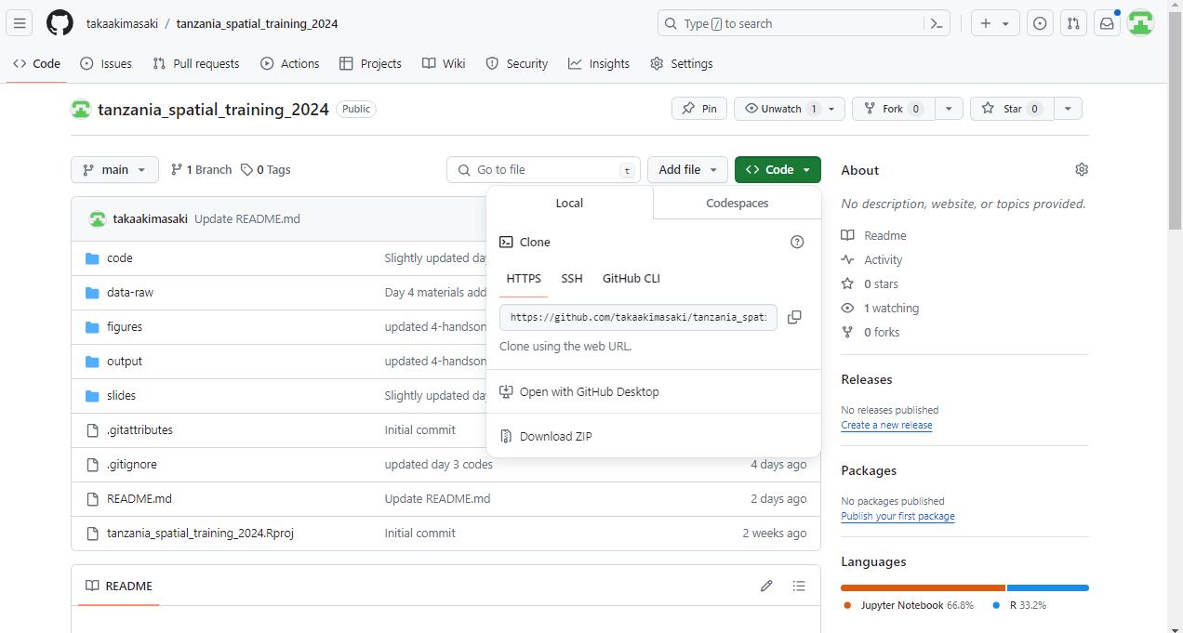
Copy (or clone) the repository to your local machine
Open GitHub Desktop on your laptop and sign in
Copy (or clone) the repository to your local machine by clicking on “Code”
Select “Open with GitHub Desktop”

Slide 22
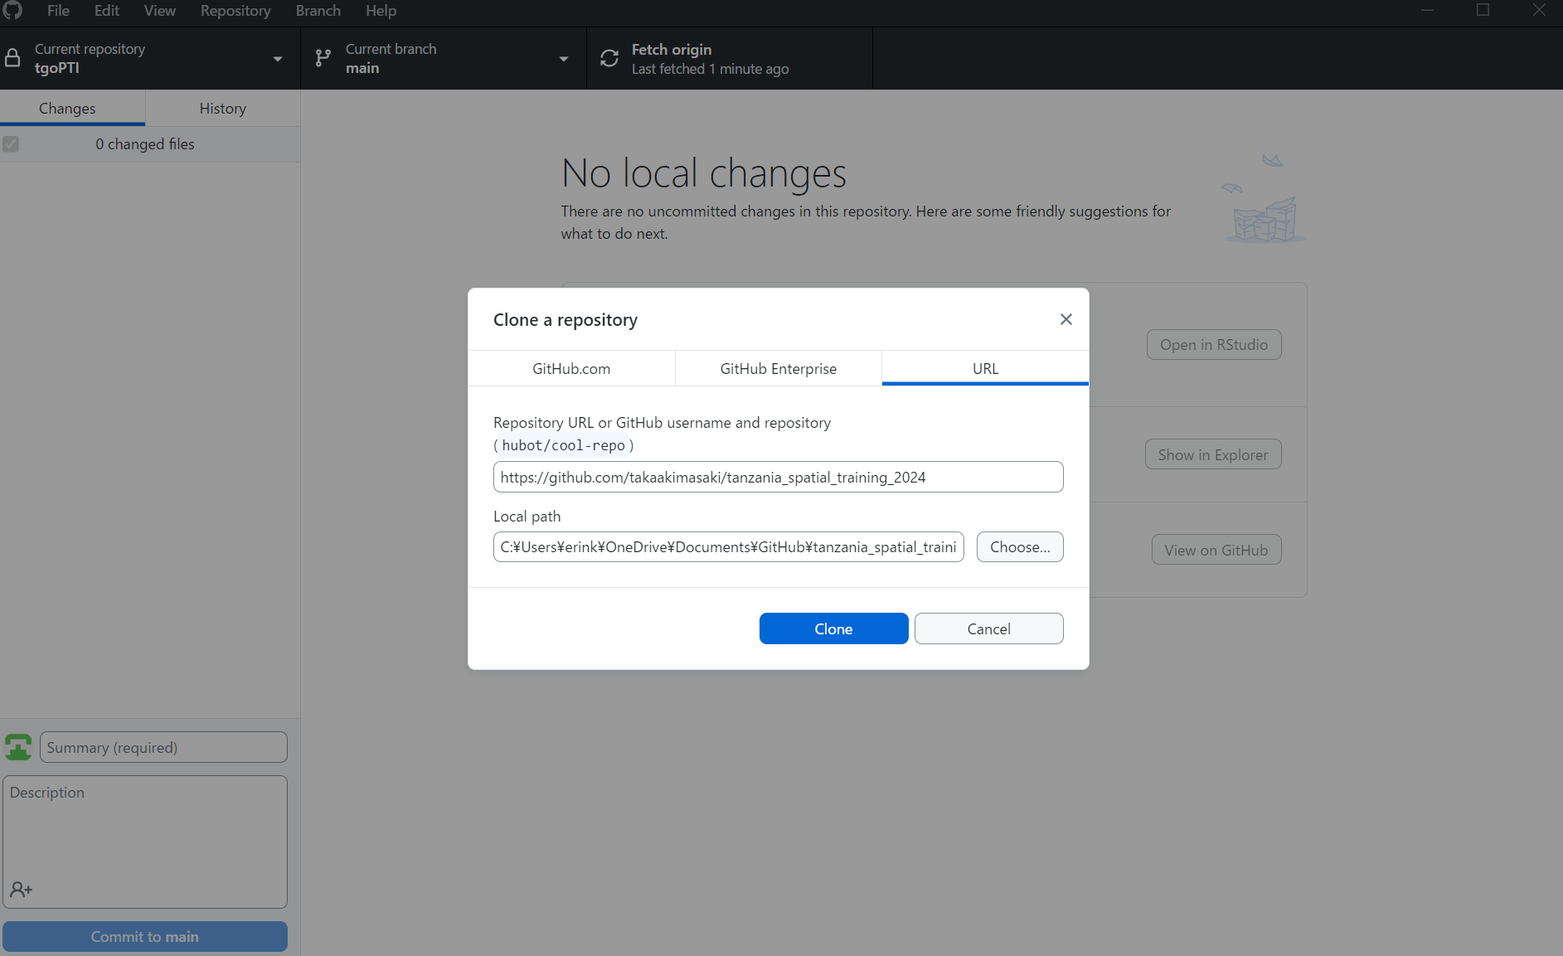
Copy (or clone) the repository to your local machine
GitHub Desktop then asks you to set a local path where a copy of the repository will be saved on your local computer
By default, a cloned repository will be saved in C:\Users\XXX\Documents\GitHub

Slide 23
Add a file to your local repo and "commit" (save) the changes
Add a file to your local repo and "commit" (save) the changes
For instance, we write a script in a DO file and save it in C:/Users/xxx/Documents/GitHub/tanzania_spatial_training_2014/code/
Now you see all changes you made in your local repository in GitHub Desktop
Now “Commit to master” to keep record of changes you made
Note that the changes you made so far are only available on your local computer, not on GitHub
This means that your collaborators still don’t see these changes

Slide 24
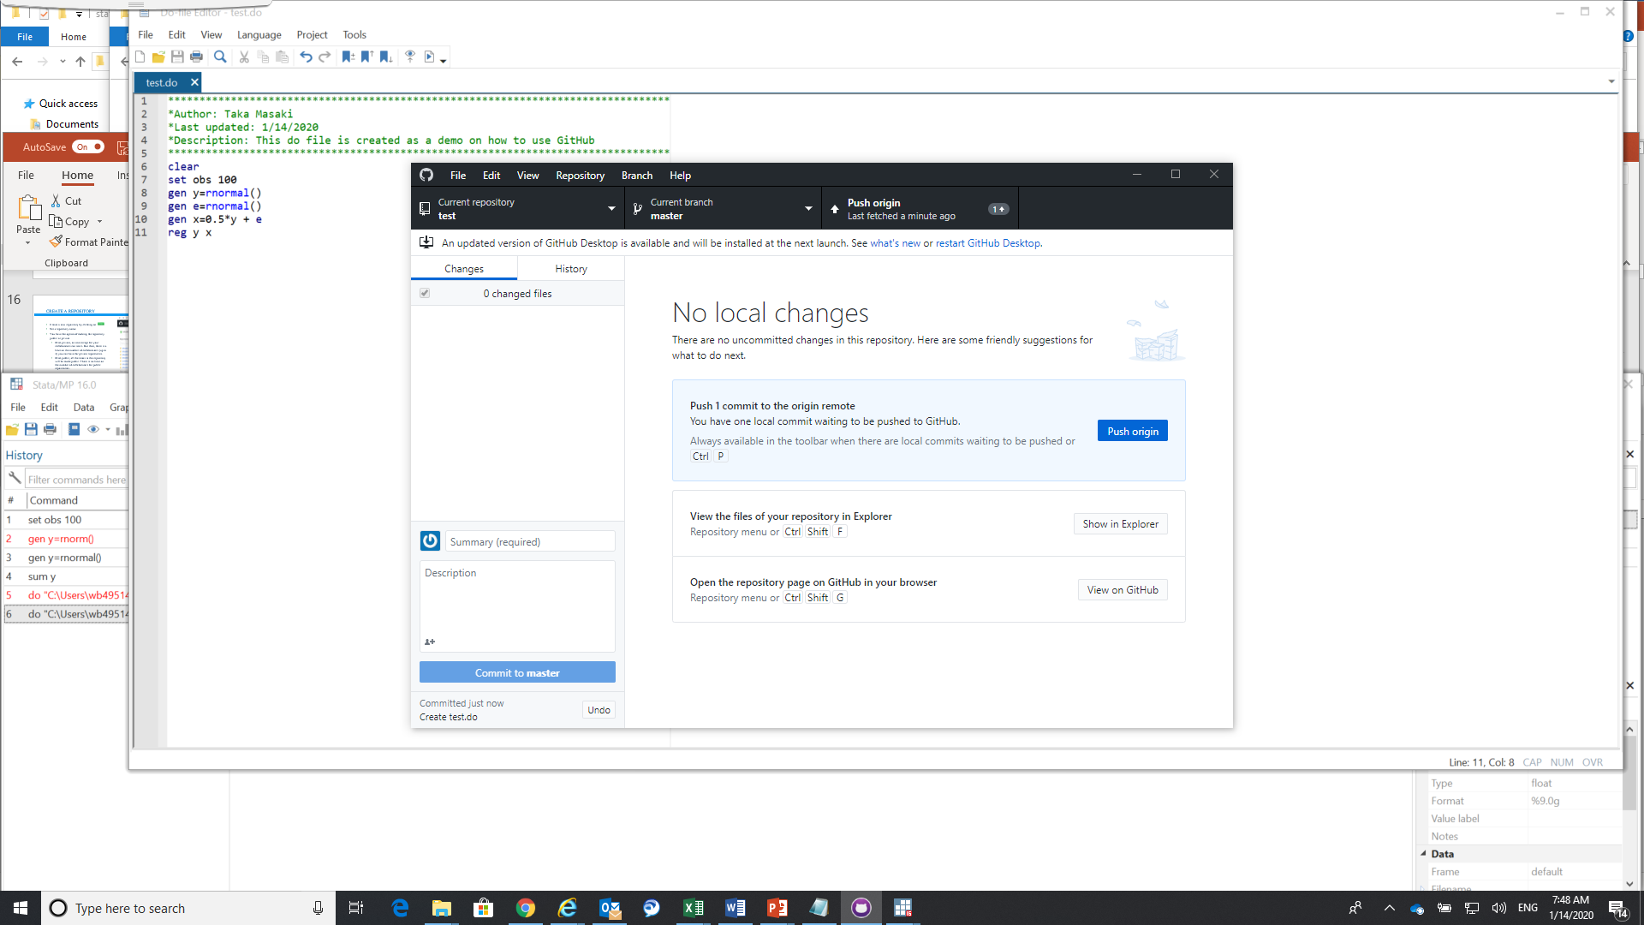
Add a file to your local repo and "commit" (save) the changes
Add a file to your local repo and "commit" (save) the changes
For instance, we write a script in a DO file and save it (let’s call it test.do) in C:\Users\wb[UPI]\Documents\GitHub\test
Now you see all changes you made in your local repository in GitHub Desktop
Now “Commit to master” to keep record of changes you made
Note that the changes you made so far are only available on your local computer, not on GitHub
This means that your collaborators still don’t see these changes
Push these changes by clicking on
Now these changes are reflected in GitHub
Collaborators can also see these changes

Slide 25
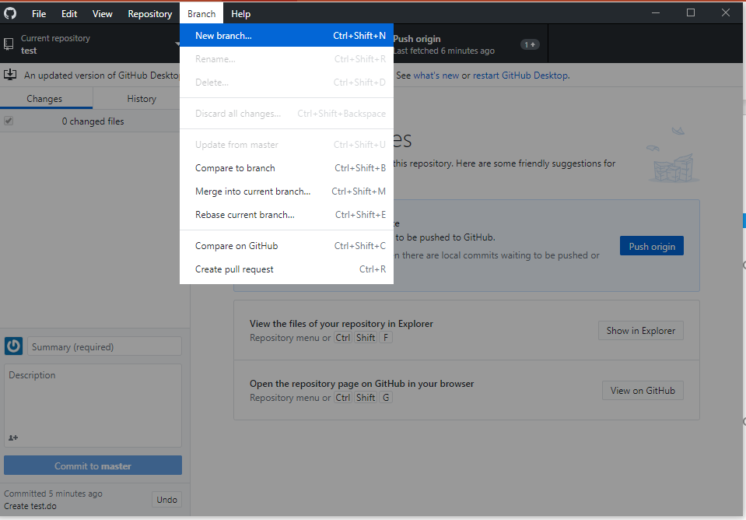
Create a "branch" (version), make a change, commit the change
You want to keep master branch clean meaning that you don’t want to push changes directly to the master branch
Instead, generate a branch for any specific task or development work that you work on
To create a branch, select “Branch” and “New branch”
See this article on branch name conventions
For now, we create a new branch called test_branch

Slide 26
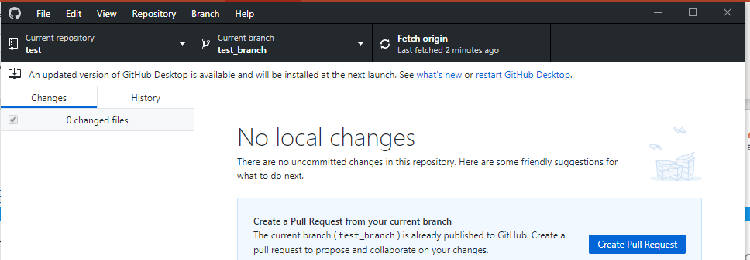
Create a "branch" (version), make a change, commit the change
You want to keep master branch clean meaning that you don’t want to push changes directly to the master branch
Instead, generate a branch for any specific task or development work that you work on
To create a branch, select “Branch” and “New branch”
See this article on branch name conventions
For now we create a new branch called test_branch
Notice that your current branch is now test_branch

Slide 27
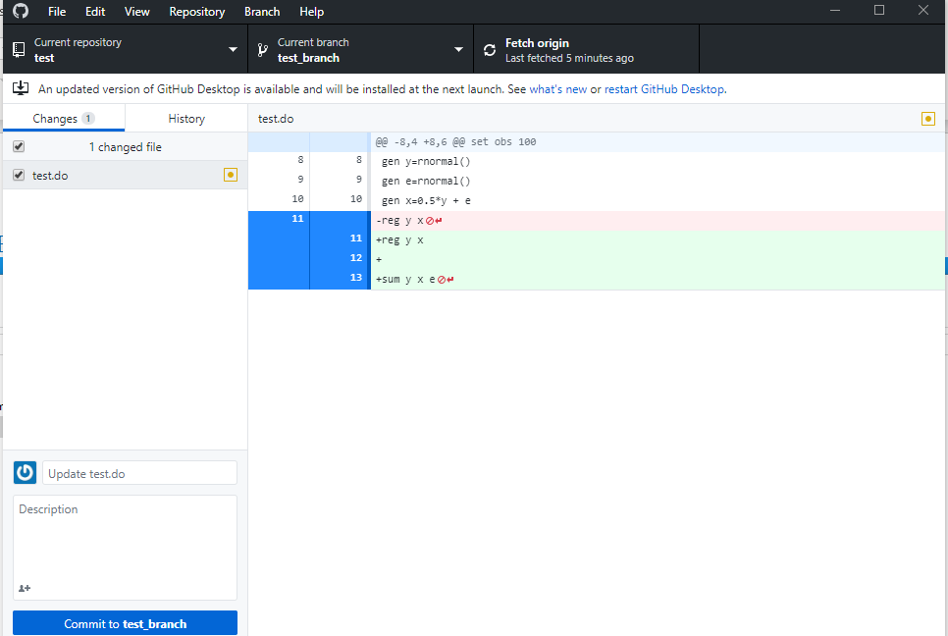
Create a "branch" (version), make a change, commit the change
You want to keep master branch clean meaning that you don’t want to push changes directly to the master branch
Instead, generate a branch for any specific task or development work that you work on
To create a branch, select “Branch” and “New branch”
See this article on branch name conventions
For now we create a new branch called test_branch
Notice that your current branch is now test_branch
Make edits in test.do, save the revised DO file, and commit in test_branch

Slide 28
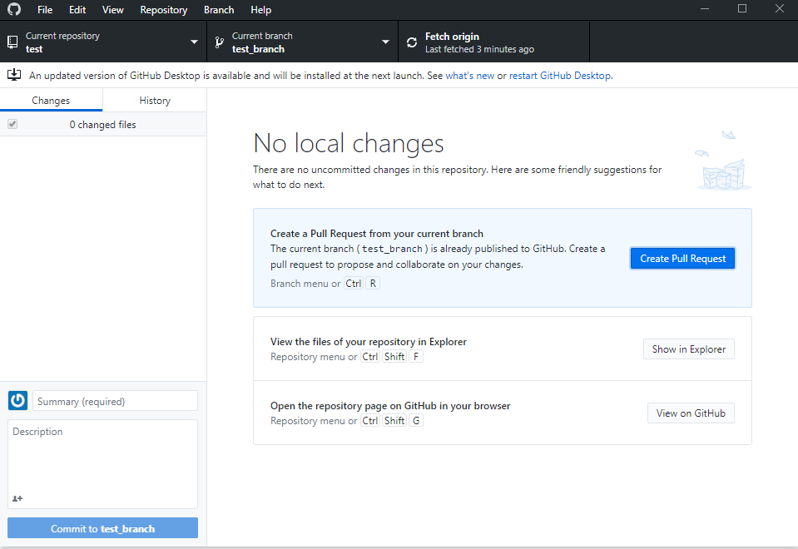
Open a "pull request" (propose changes to the master branch)
Open a "pull request" (propose changes to the master branch) by clicking on “Create Pull Request”

Slide 29
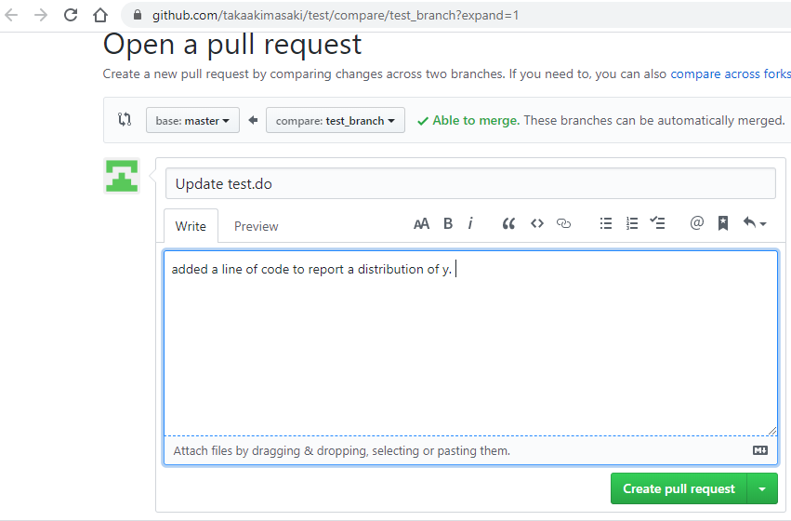
Open a "pull request" (propose changes to the master branch)
Open a "pull request" (propose changes to the master branch) by clicking on “Create Pull Request”
Provide a brief description of what you have worked in the given branch
Click on “Create pull request”

Slide 30
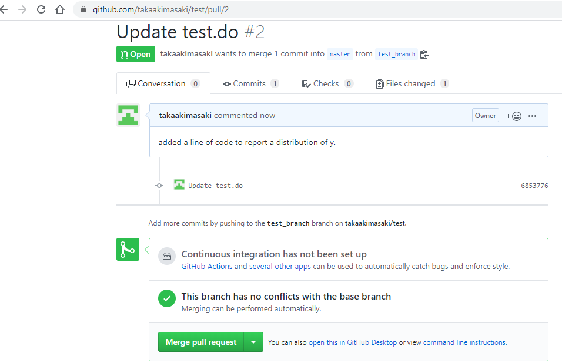
Open a "pull request" (propose changes to the master branch)
Open a "pull request" (propose changes to the master branch) by clicking on “Create Pull Request”
Provide a brief description of what you have worked in the given branch
Click on “Create pull request”
Finally, “Merge pull request” to merge those changes into the master branch

Slide 31
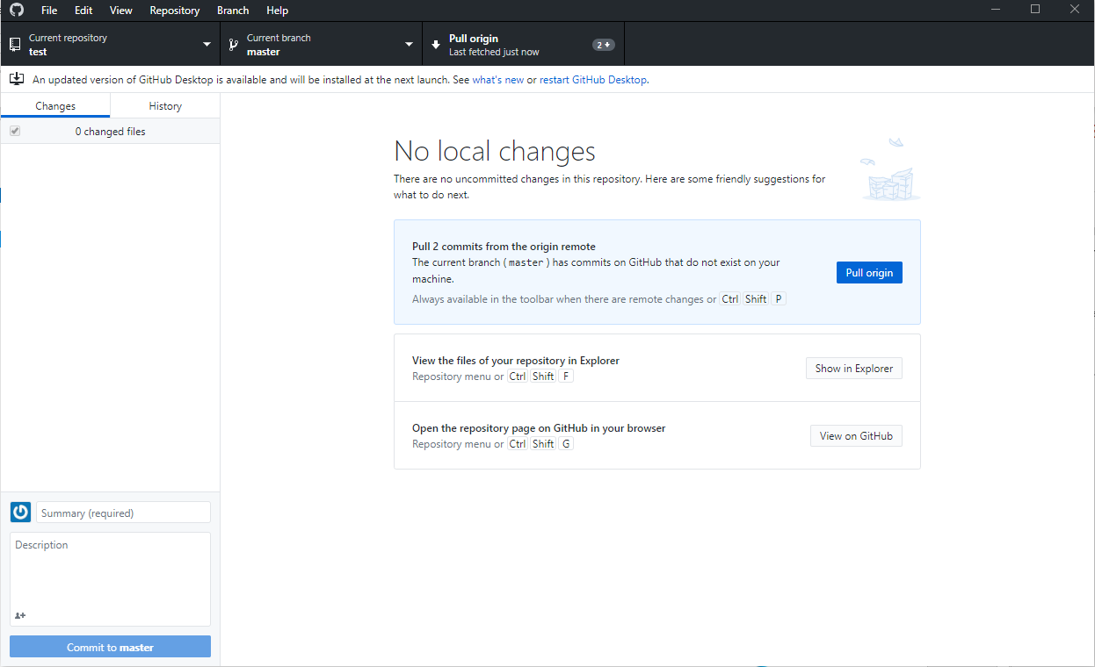
Open a "pull request" (propose changes to the master branch)
Open a "pull request" (propose changes to the master branch) by clicking on “Create Pull Request”
Provide a brief description of what you have worked in the given branch
Click on “Create pull request”
Finally, “Merge pull request” to merge those changes into the master branch
Note that the pull request is now reflected in the master branch on GitHub but not in your own copy of the master branch on your local computer
To “pull” those changes from GitHub, you can switch to master under “Current branch” and click on “Pull origin”

Slide 32
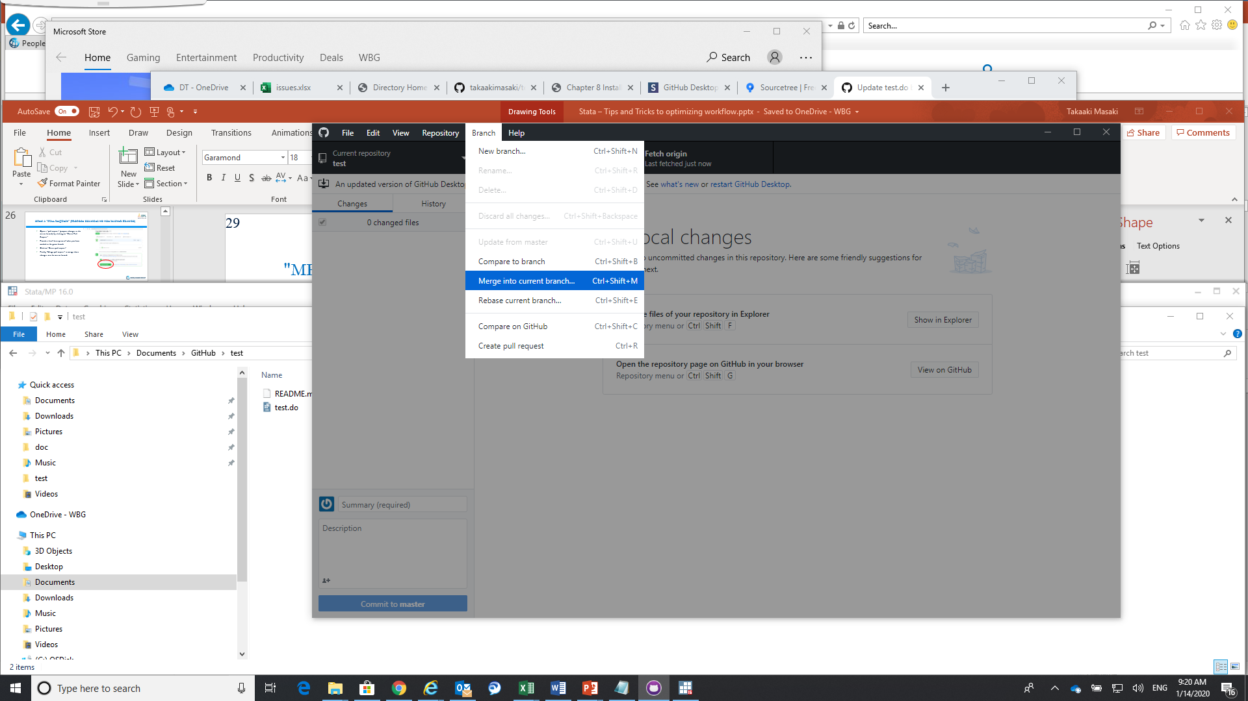
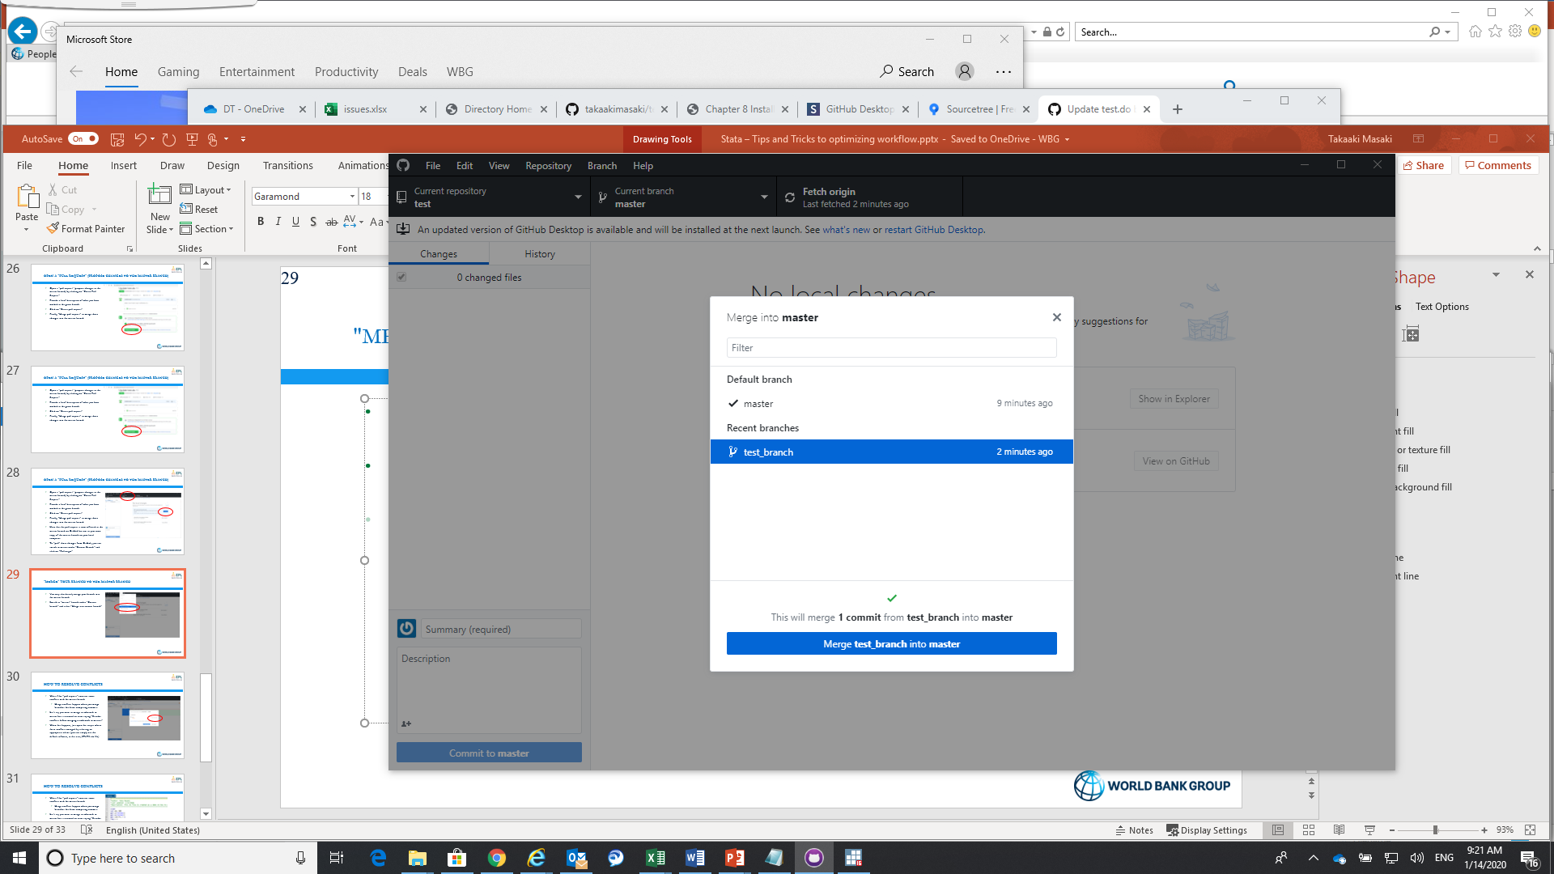
"Merge" your branch to the master branch
You may also directly merge your branch into the master branch
Switch to “master” branch under “Current branch” and select “Merge into current branch”
Select the branch that you would like to merge into current branch (in this case, “master”)
Once the merge is done, you see changes you made in test_branch will be reflected in the master branch.

Slide 33
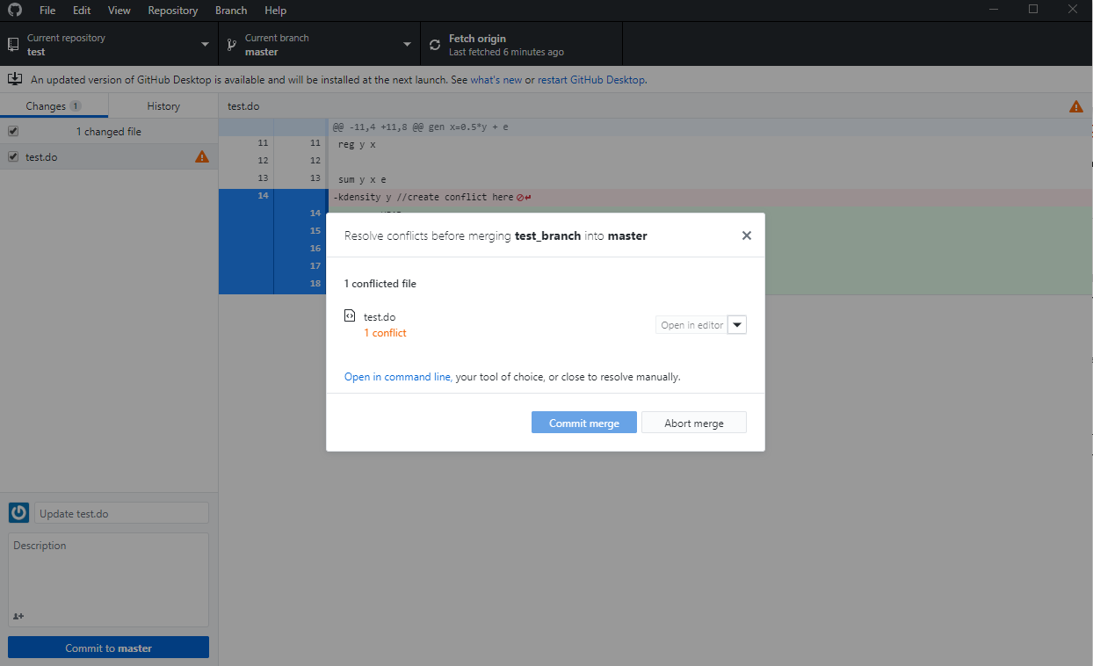
How to resolve conflicts
What if the “pull request” contains some conflicts with the master branch
Merge conflicts happen when you merge branches that have competing commits
Let’s say you want to merge test_branch to master but it returned an error saying “Resolve conflicts before merging test_branch to master.”
When this happens, just open the scripts where these conflicts emerged by selecting an appropriate editor (you can simply use the default software, in this case, STATA do file)

Slide 34
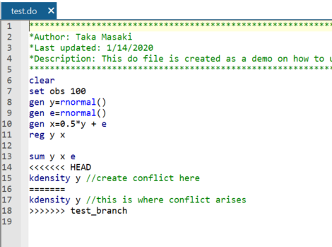
How to resolve conflicts
What if the “pull request” contains some conflicts with the master branch
Merge conflicts happen when you merge branches that have competing commits
Let’s say you want to merge test_branch to master but it returned an error saying “Resolve conflicts before merging test_branch to master.”
When this happens, just open the scripts where these conflicts emerged by selecting an appropriate editor (you can simply use the default software, in this case, STATA do file)
Conflicts are noted as “<<<<” and “>>>>”

Slide 35
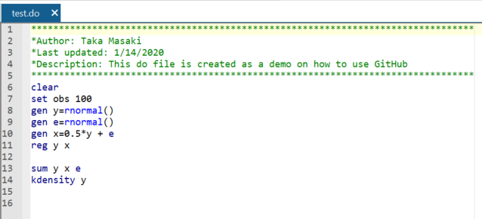
How to resolve conflicts
What if the “pull request” contains some conflicts with the master branch
Merge conflicts happen when you merge branches that have competing commits
Let’s say you want to merge test_branch to master but it returned an error saying “Resolve conflicts before merging test_branch to master.”
When this happens, just open the scripts where these conflicts emerged by selecting an appropriate editor (you can simply use the default software, in this case, STATA do file)
Conflicts are noted as “<<<<” and “>>>>”
Just clean up those conflict signs and save as a new file in the master branch
See more on how to resolve conflicts here

Slide 36
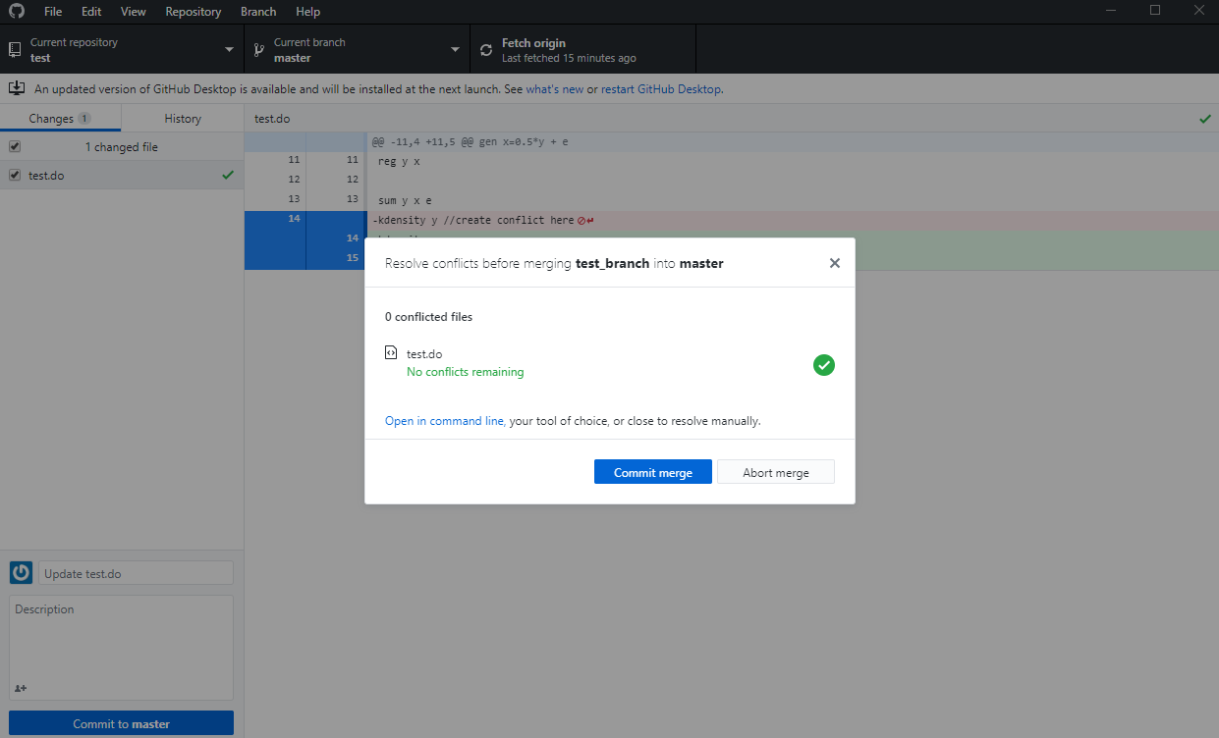
How to resolve conflicts
What if the “pull request” contains some conflicts with the master branch
Merge conflicts happen when you merge branches that have competing commits
Let’s say you want to merge test_branch to master but it returned an error saying “Resolve conflicts before merging test_branch to master.”
When this happens, just open the scripts where these conflicts emerged by selecting an appropriate editor (you can simply use the default software, in this case, STATA do file)
Conflicts are noted as “<<<<” and “>>>>”
Just clean up those conflict signs and save as a new file in the master branch
Now you can commit merge

